Slide 1
Data Visualization & Exploration – COMPSCI 590
Lab 1: D3 Setup
John Fallon
1-25-2019

Slide 2
Lab 1 Goals
Understand what D3 is
Be able to locally run D3 code on your machine
Get an example D3 visualization showing in the web browser

Slide 3
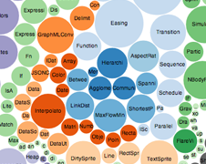
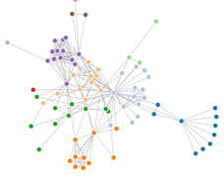
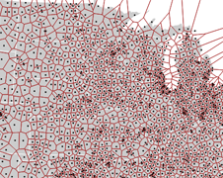
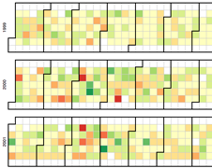
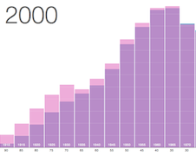
What is D3?

Slide 4
What is D3?
D3.js is a JavaScript library for manipulating documents based on data. (https://d3js.org/)
At it’s core, D3 is a graphics library for the web
D3 is a targeted library – data visualization
D3 visualizations can be embedded into any web page
D3 Links:
Homepage: https://d3js.org/
Github: https://github.com/d3/d3
Latest Online Release: https://d3js.org/d3.v5.min.js

Slide 5
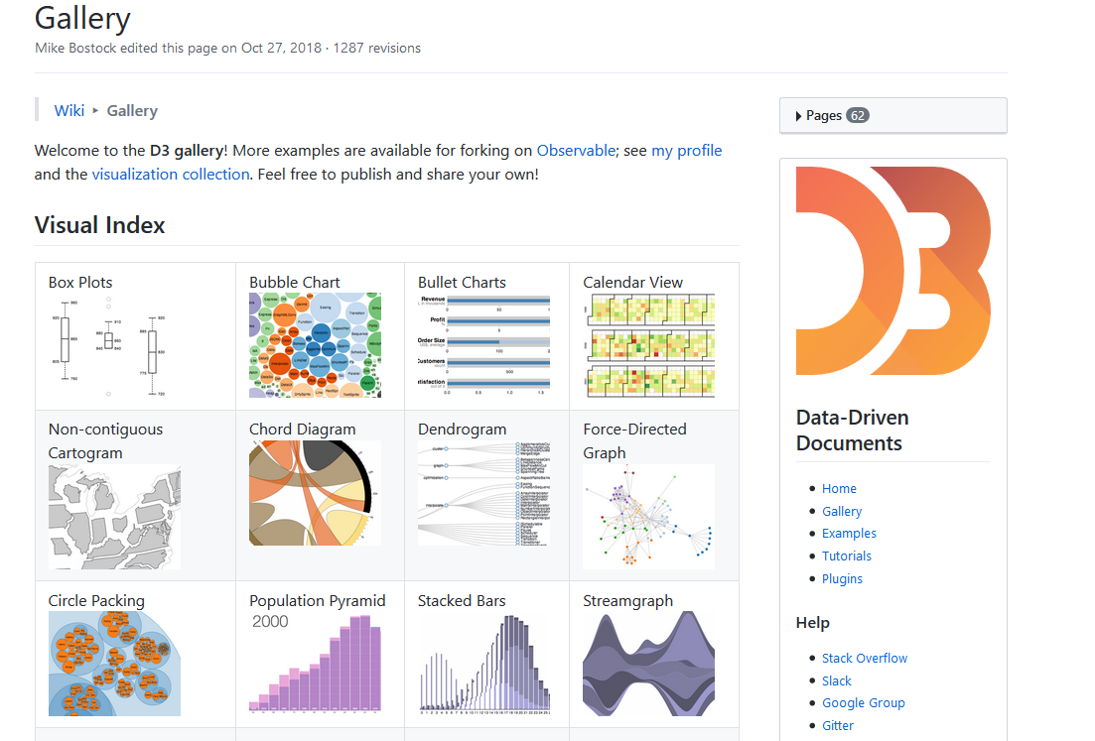
D3 Live Examples
D3 Examples page: https://github.com/d3/d3/wiki/Gallery
Can there be more content on web page than just a D3 visualization?
Does D3 support interaction?
Can there be multiple D3 visualizations on one web page?
Notes:
Linked Visualization: http://bl.ocks.org/mattykuch/40ba19de703632ea2afbbc5156b9471f

Slide 6
Running D3
What does D3 require to run?
A web browser
D3 source code
Valid HTML document
Server
Most people probably have a web browser
D3 source code can be added to any HTML file by including:
<script src="https://d3js.org/d3.v5.min.js"></script>
Server:
Can use a remote setup like: https://bl.ocks.org/
Host a local server

Slide 7
Remote Server – Using bl.ocks
Bl.ocks.org is the website of Mike Bostock
Mike Bostock is the creator and maintainer of D3
Bl.ocks.org can point to a Gist on Github
Gist is a one off mini-repo
Bl.ocks.org is an easy way to share your visualization on the web without having to worry about hosting
Bl.ocks.org has a great collection of D3 examples alongside their code. Reference it!
Another good resource: https://blockbuilder.org/

Slide 8
Local Server - Python
Running D3 locally requires a server
I recommend Python, since it is easy and straightforward
Mac comes pre-installed with Python 2.7. Windows will need to install Python
Python 2.X or 3.X will work, but there are different commands to run a server
Install Python from: https://www.python.org/downloads/

Slide 9
Python Server Commands
In a command prompt, make sure you are in the same directory as your D3 code and files.
Then run the command:
Python 2 server command: python -m SimpleHTTPServer 8000
Python 3 server command: python3 -m http.server 8000
The 8000 number is the port number. This number can be any non-conflicting number with already existing ports. 8000 is a typical testing port.
Valid URL should be: http://localhost:8000

Slide 10
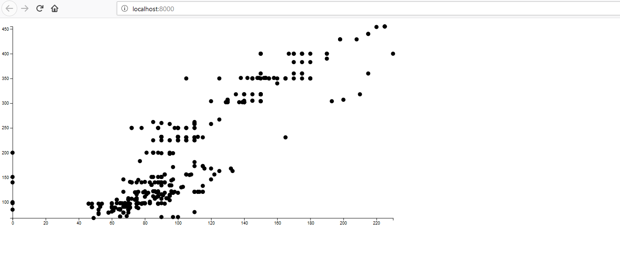
Is My Server Working?
If the previous command worked, going to localhost:8000 should either produce:
Directory Listing
Webpage if an index.html was present
Using the Lab 1 Files you should see…:

Slide 11
Server Success
If you see the visualization on the localhost webpage, Congratulations!
You’ve now successfully run a D3 visualization using your local environment
If you want to explore further/debug the example try opening the Developer Tools in the web browser. (F12 in Chrome and Firefox)

Slide 12
Digging Into Starting D3
We will examine the bare bones needed to start D3 development
In the Lab 1 Files, there is a file called: simple.html

Slide 13
Simple.html
If we want our server to display that page in our browser we can go to: localhost:8000/simple.html
We could also change simple.html to be called index.html, and our localhost:8000 will default to that page
Key components of this file:
Valid HTML
Included script tag for D3 source

Slide 14
Javascript Console
Let’s test using D3 live: d3.select("body").append("p");
D3 Select
The D3.js Select method uses CSS3 selectors to grab DOM elements
D3 looks at the document and selects the first descendant DOM element that contains the tag body
Once an element is selected, D3.js allows you to apply operators to the element you have selected
These operators can get or set things like "attributes", "properties", "styles", "HTML", and "text content“
D3 Append
The Append Operator appends a new element as the last child of the element in the current selection
Since our current selection was d3.select("body"), the append operator added the "p" element last.

Slide 15
For Next Time…
Playing around with SVG elements
Start talking about groups for the term project
Teams should have Undergraduates and Graduates
Questions?

