Slide 1
Data Visualization & Exploration – COMPSCI 590
Introduction to Information Visualization
Ali Sarvghad
Spring 2018
Notes:
Hello everybody and welcome to Data Visualization and Exploration course.
This class is an introduction to the course

Slide 2
What is information visualization?
My elevator pitch:
  Presenting data via interactive charts, graphs, maps etc. so that users can understand the data, answer questions about data, and gain insights

Slide 3
What is information visualization?
The engineering definition
  Binding data values and structures to graphical elements on a display
Other definitions:
  Use of computer-supported, interactive visual representations of data to amplify cognition (Card, Mackinlay, Schneiderman’ 98)
  The depiction of information using spatial or graphical representations, to facilitate comparison, pattern recognition, change detection, and other cognitive skills by making use of the visual system (Hearst’ 03)

Slide 4
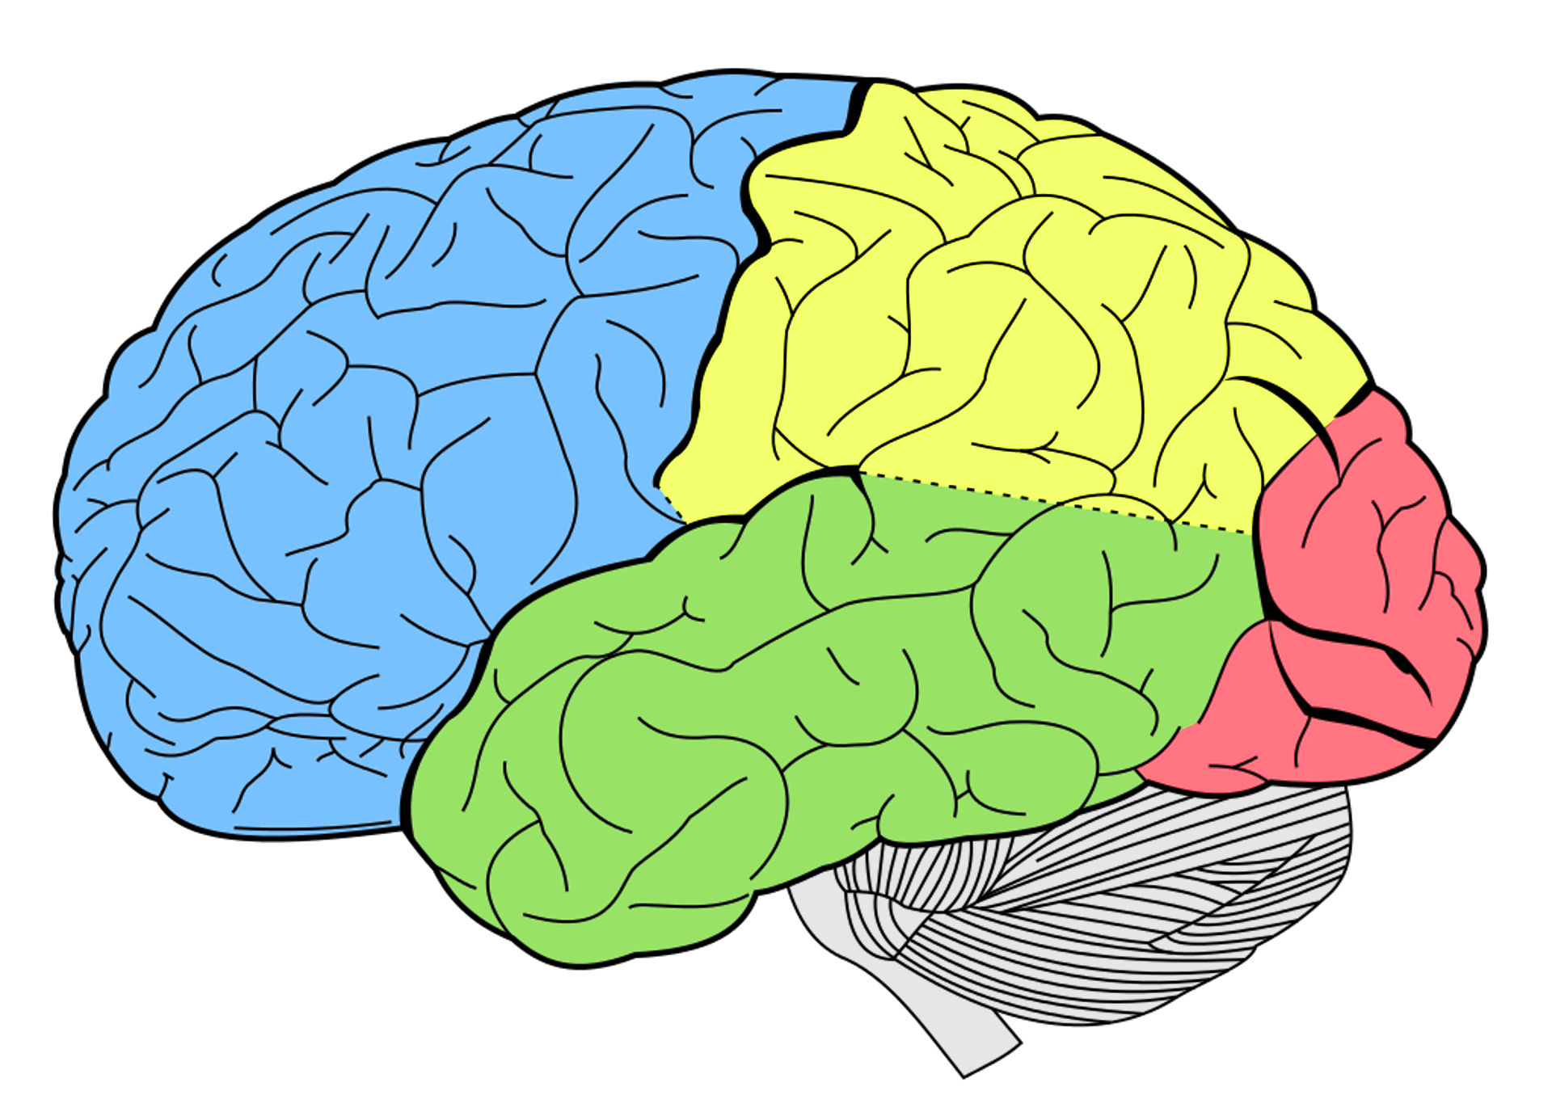
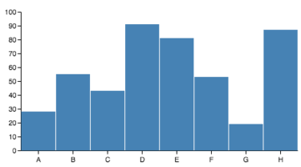
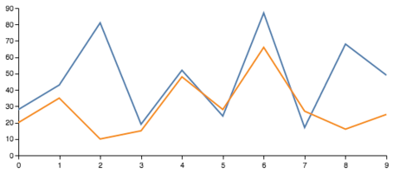
How does it work?
Data
What user wants to do?
We look at
that picture searching for patterns
Insight
Compare categories?
Temporal trends?
Notes:
This is a high level presentation of visualization pipeline, where at one end you have data, and on the other end, you have insights and discoveries

Slide 5
How does it work?
Human vision system is extremely capable at fast recognition of shapes, patterns, and outliers
Lets look at a fun example!

Slide 6
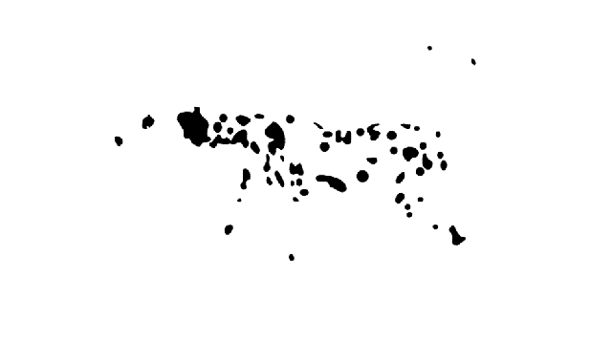
How does it work?
Notes:
What is here is actually a bunch of moving black marks! But what you SEE is thoroughly amazing!
Most probably you are seeing a dalmatian walking fast!
But why? How your brain turned a bunch of moving marks into dog?
There are many theories and principles that explain how visual system work the way it does.
This specific example shows a Gestalt principles of Continuity and Common Fate..

Slide 7
When visualization can be useful?
For well-defined questions to ask about data, you can use purely computational techniques from fields such as statistics and machine learning.
  E.g. Systems for stock trading that makes data-driven decisions automatically
However, many analysis problems are ill specified
  People don't know how to approach the problem
  Vague high-level questions and hypotheses, but not which ones are right
  In this case, best path forward is an analysis process with a human in the loop
  Utilize powerful pattern detection properties of the human visual system
Notes:
When people have well-defined questions to ask about data, they can use purely computational techniques from fields such as statistics and machine learning.

Slide 8
When visualization can be useful?
Goal: Improve HIV prevention planning
Understand HIV transmission patterns & characteristics
HIV transmission is a complex interplay between various social, demographic, geographic, clinical,…, factors
HIV researchers (i.e. human in the loop) had many questions and hypotheses which needed answering/evaluating
Built a exploratory data analysis tool: Avant-garde
Notes:
When people have well-defined questions to ask about data, they can use purely computational techniques from fields such as statistics and machine learning.

Slide 9
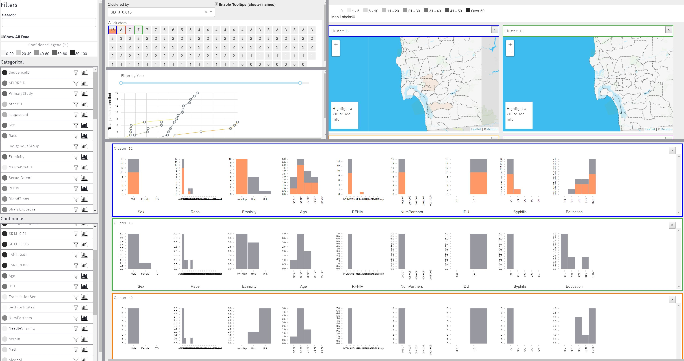
When visualization can be useful?

Slide 10
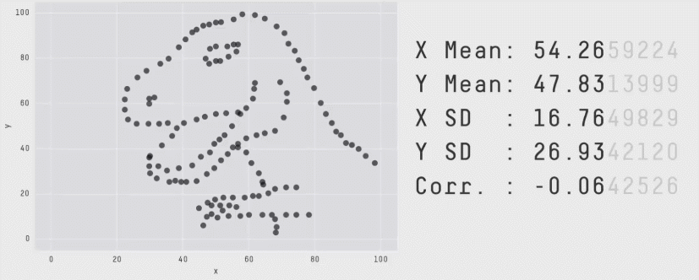
When visualization can be useful?
Matejka, Justin, and George Fitzmaurice. "Same stats, different graphs: generating datasets with varied appearance and identical statistics through simulated annealing." Proceedings of the 2017 CHI Conference on Human Factors in Computing Systems. ACM, 2017.
Notes:
When people have well-defined questions to ask about data, they can use purely computational techniques from fields such as statistics and machine learning.

Slide 11
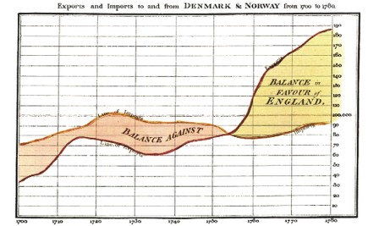
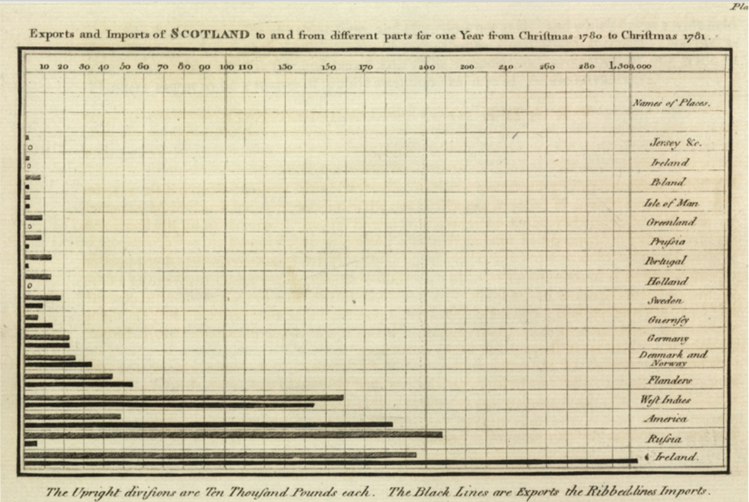
What do we usually use visualization for?
Analyze
Trade-balance time-series chart
Scotland's imports and exports in 1781
William Playfair
Notes:
These two examples from William Playfair, who is the The founder of graphical methods of statistics
In fact he has invented several types of very common charts that we use today like line, area, and bar charts.

Slide 12
What else can we use visualization for?
Analyze data to support reasoning
  Develop and assess hypotheses , find patterns and discovers errors in data
  -…
Is this the only way visualization can be utilized?
  NO!
Communicate information to others
  Share and persuade, storytelling, …
Record information
  Blueprints, photographs, …
Enjoyment

Slide 13

What else can we use visualization for?
Communicate information
Notes:
When it comes to using visualization for communication, I cannot think of better example than Hans Rosling talks!

Slide 14
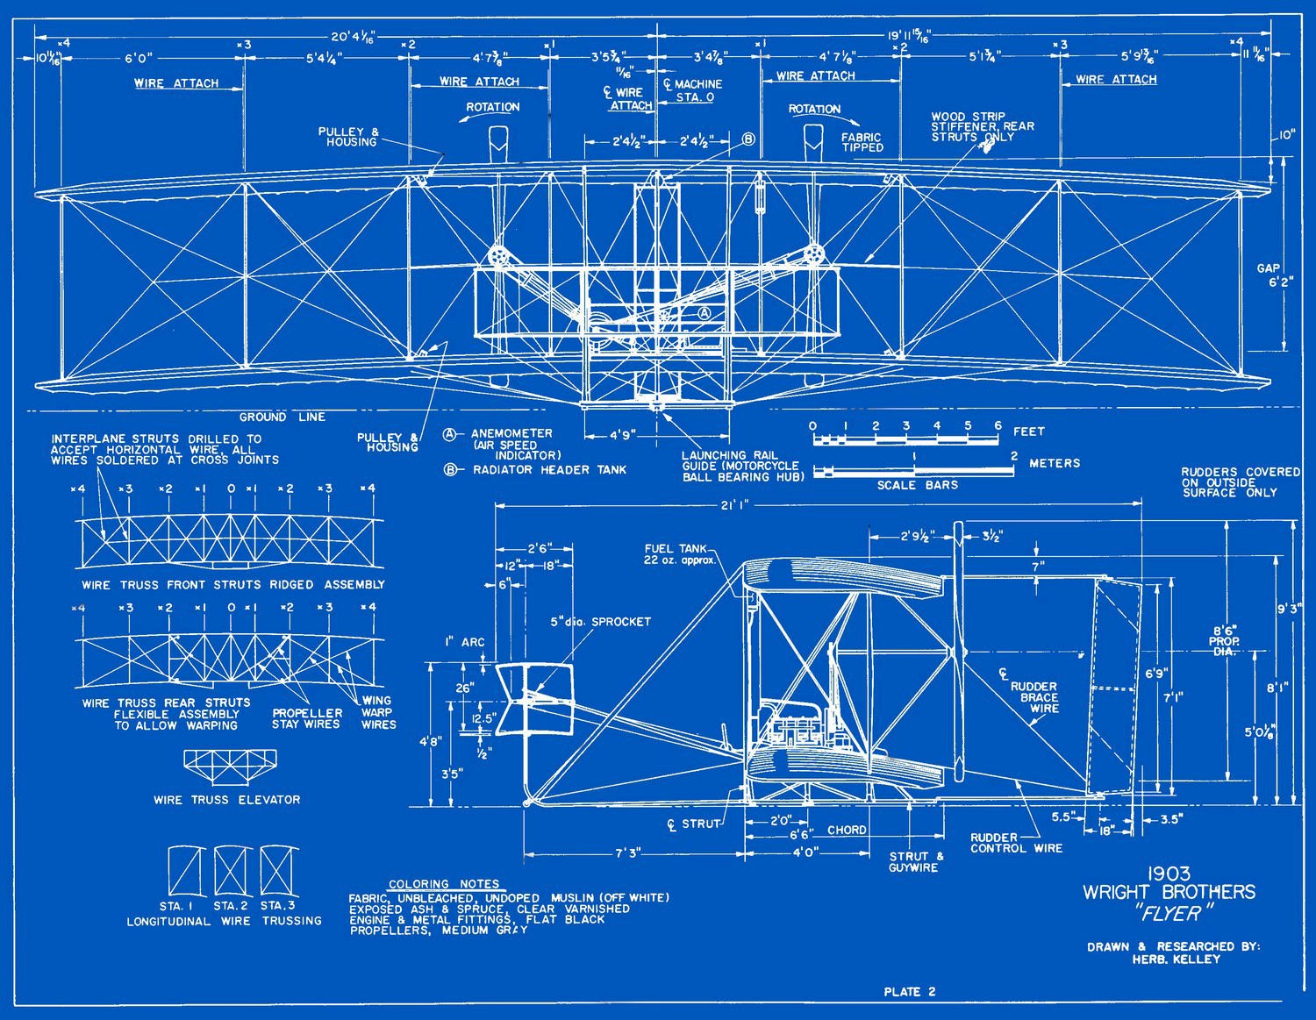
What else can we use visualization for?
Record information
Wright brothers plane, 1903

Slide 15
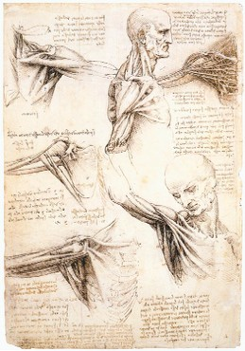
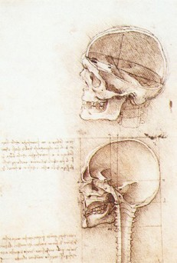
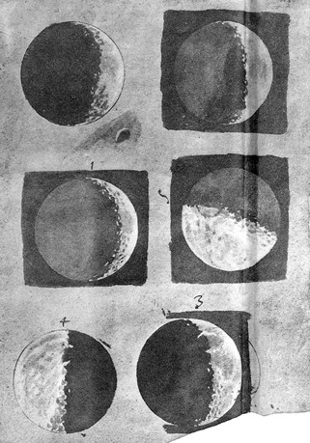
What else can we use visualization for?
Record information
Leonardo Da Vinci, ca. 1500
Galileo Galilei, 1616

Slide 16
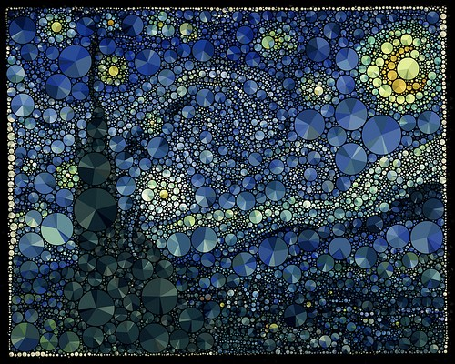

What else can we use visualization for?
Enjoyment
Notes:
The pie charts represent the distribution of dominant colors within a circle area.

Slide 17
Questions?
Notes:
Hello everybody and welcome to Data Visualization and Exploration course.
This class is an introduction to the course

Slide 18
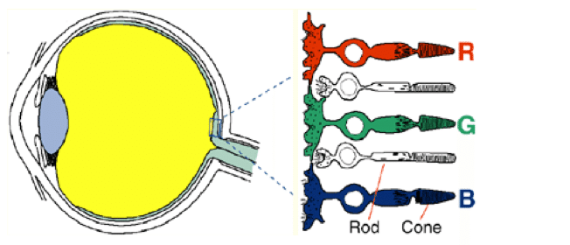
How does it work?
Rods
  Vision in low-light setting
  Provide low-resolution black & white information
Cones
  Active at higher light levels
  R, G, B types
  Mediate color vision
Notes:
How does human’s visual system works?
Our eyes do a lot of preprocessing before sending the signals to our brains for higher level processing
Our retina has two different kinds of receptors Rods & Cones
Rods

Slide 19
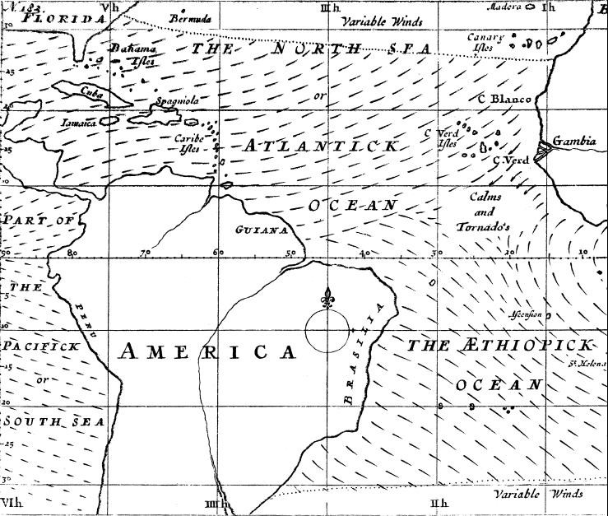
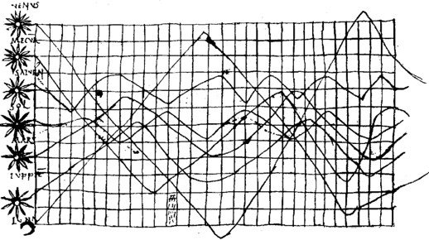
What do we usually use visualization for?
Analyze
Planetary Movement Diagram, c. 950
Halley’s Wind Map, 1686

Slide 20
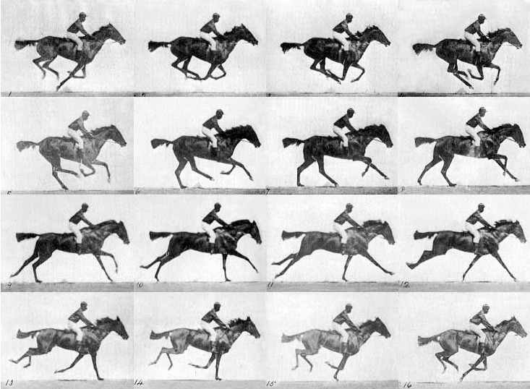
What else can we use visualization for?
Record information
E. J. Muybridge, 1878
Notes:
Eadweard Muybridge was an English photographer important for his pioneering work in photographic studies of motion, and early work in motion-picture projection.

