Slide 1
Data Visualization & Exploration – COMPSCI 590
Course Introduction
Ali Sarvghad
Spring 2018

Slide 2
Course overview
What the course is about
What will you learn
Teaching team
Schedule
What you need to do to succeed
Notes:
Hello everybody and welcome to Data Visualization and Analysis course.
In our first class today, I am going to tell you about the course, what to will hopefully learn, and what you need to do in order to successfully complete the course
Let me start by introducing myself:
My name is Ali
I got my PhD in computer science from University of Victoria in Canada, and I did a two year postdoc at UCSD before joining UMass
My research areas are information visualization, visual analytics, computer supported collaborative work, and interaction design

Slide 3
What this course is about
Visualization analysis & design
  What visualization can do?
  When it make sense to visualize data?
  How to design effective visualizations?
Fundamental principals of data exploration and analysis
  How to enable data exploration and insight discovery?
  Interaction
  Multiple and coordinated views
Using technology to create interactive visualizations
  How to use D3.js and Java Scripting to create interactive visualizations
Notes:
These are the three main components and topic areas that this course will cover:
Frist one which the core component, is Visualization Analysis and Design. Here we talk about the systemic process of building effective visualization based on data, user tasks, and our visual data processing capabilities and perception
Second component touches on topics related to enabling data exploration and insight discover. Different interaction mechanisms, principles guiding interaction design, a other techniques such as multiple and coordinated views
We cover these two components in lectures on Mondays and Wednesdays
We also want you to gain hands-on, real experience, building visualizations, so we are going to have labs, on Fridays, and in the labs, you get to experience using D3 and Javascript for building webbased interactive visualizations

Slide 4
What will you learn
Systematic process of visualization analysis and design
  Data abstraction
  Task abstraction
  Marks & channels
  ….
Fundamental visualization techniques for
  Tabular data
  Network data
  Geo/spatial data
Practical experience building interactive visualizations
  Creating online interactive visualizations
Notes:
So to sum it up, these are some of the topics and skills that you will hopefully have learned about at the end of this course

Slide 5
Teaching team
Ali Sarvghad (instructor)
  Office hours : Mondays 3-4:30 PM. Other times, by appointment only.
John Fallon (TA)
  Ph.D. candidate
  jfallon@cs.umass.edu
  Office hours: Friday 11:30-1 pm, CICS 311, Cube 2
Soha Rostaminia (TA)
  Ph.D candidate
  srostaminia@cs.umass.edu
  Office hours: Wednesday 4-6 pm, LGRT T220

Slide 6
Schedule - Lectures and Labs
Lectures: Mondays and Wednesday
  Theories and foundations of information visualization
Labs: Fridays
  Learn about D3
  Work on group projects (after midterm)

Slide 7
Expectations & evaluation
Expectations
  Attendance
  Assignments
  Midterms
  Term project
  Popup quizzes
  Participation in forums and online activities
Notes:
Ok, any questions so far?

Slide 8
Expectations & evaluation
Evaluation
  Assignments (30%)
  Midterms (20%)
  Term project (45%)
  Class participation (5%)
Notes:
Ok, any questions so far?

Slide 9
Expectations & evaluation
Homework Assignments
  These assignments will help you develop your knowledge for design principles for Information Visualization
  Four assignments
    HW1: 8% (of the total 30% assignments’ weight)
    HW2: 8%
    HW3: 8%
    HW4: 6%
  Individual
  Submitted online
  Details about what’s expected, deadline, and how to submit on course website
Midterm
  In class midterm, last Wednesday before the Spring break

Slide 10
Expectations & evaluation
Course Project
  Groups (3-4)
  Each group must be a mix of grad and undergrad students
  You will need to find a dataset and problem
  Project will have deliverables that are due throughout the course
    Proposed solution
    Implementation of your solution
    Final presentation

Slide 11
Expectations & evaluation
Popup quizzes
  on Mondays at the begging of the class (be on time)
  You will be tested on the subjects taught the week before
  A few (usually multiple choice) questions
  Also counts as attendance

Slide 12

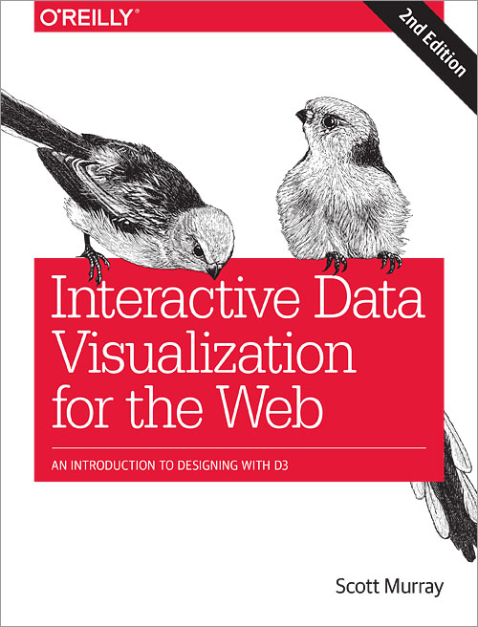
Resources

Slide 13
Resources
Course website
  http://groups.cs.umass.edu/asarv/data-visualization-and-analysis-compsci-590v-spring-2018/
  Detailed information about schedule, assignments, projects and important due dates
  Lecture notes
  Useful readings and other resources
Teaching assistants
  John
  Soha

Slide 14
Resources
Course Moodle
  Used for announcements
  Handing in assignments
  Forums and group discussions
    You should participate in both asking and answering the questions
  Grades will be posted on Moodle
Notes:
So, any questions about the course?

Slide 15
Questions?
Notes:
Hello everybody and welcome to Data Visualization and Exploration course.
This class is an introduction to the course

